Slide 1
Audio extrapolation
Finding Unknown Audio samples
Amandeep
Ashwani Bhat
Guide: Mrs. Shaima Qureshi
Co-Guide: Ms. Azra Nazir

Slide 2
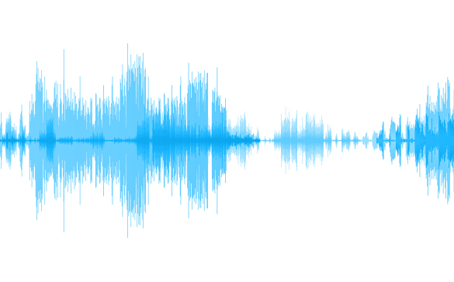
Overview
Definition
Finding unknown audio samples from the known samples.

Slide 3
Motivation
Telecommunication
Audio fingerprinting
Classification
Finding in Between Missing samples

Slide 4
objective
Given percentage of audio, find the entire audio sample.
Regression .
“Why Regression ?”

Slide 5
Models used
Support Vector Regression is used as a regression method for maintaining all the main features that characterize the algorithm (maximal margin).
A random forest is a meta estimator that fits a number of classifying decision trees on various sub-samples of the dataset.
The goal of decision tree regression is to create a model that predicts the value of a target variable by learning simple decision rules inferred from the data features.
Linear Regression
K Neighbor Regression
Models
The target is predicted by local interpolation of the targets associated of the nearest neighbors in the training set.
Linear regression is a linear approach to modelling the relationship between a scalar response (or dependent variable) and one or more explanatory variables (or independent variables)
Decision Tree Regression
Support Vector Regression
Random Forest Regression

Slide 6
WOrkflow
Getting Audio Dataset
Linear Regression
Decision Tree
Regression
Random Forest Regression
Audio Wrangling
Support Vector Regression
K Neighbor Regression
Applying Models
Model Fitting
Extrapolated Audio

Slide 7
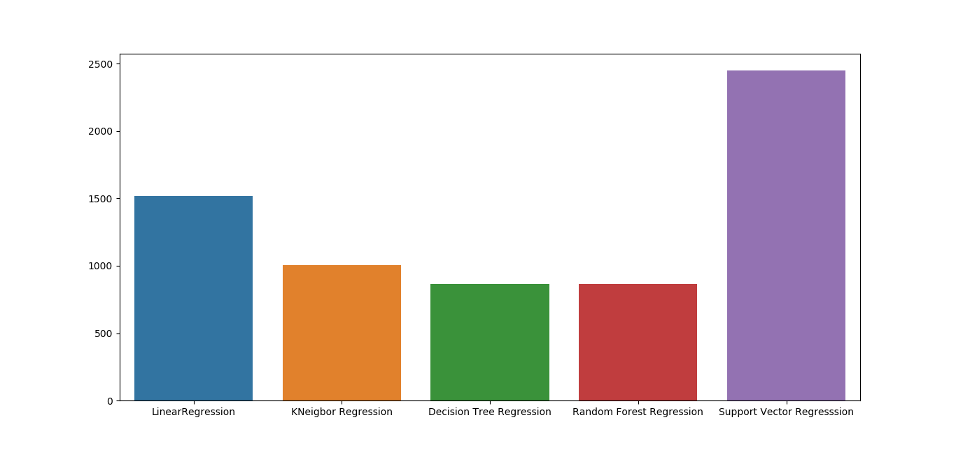
Results and conclusion
Input: 20%
Best model at 20%

Slide 8
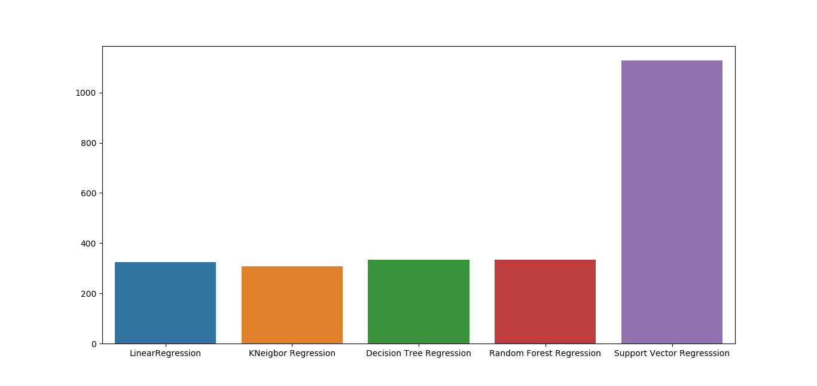
Results and conclusion
Input: 50%
For higher input percentage, nearly all the regression models are working with equal error except SVR.
Best model at 50%

Slide 9
future work
Bigger Audio dictionary
Similar Prefix Words
Extrapolating the Start
Use of other regression models

Slide 10
Thank YOu

